Slide 1
Linear Regression
Dr. Mahesh Ramalingam
Assistant Professor & Area Chairperson
Analytics & IT, IMT Hyderabad
Date: Wednesday, August 18, 2021

Slide 2
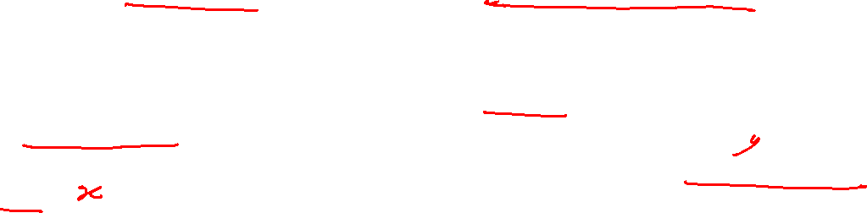
SIMPLE LINEAR REGRESSION
It is a statistical technique used for finding the existence of an association relationship between a dependent variable and an independent variable.
A regression model requires the knowledge of both outcome and feature variables in the training dataset.
This technique cannot be used for establishing causal relationship between two variables.
Following are a few examples of simple linear regression problems:
A hospital may be interested in finding how the total cost of treatment for a patient varies with his/her body weight.
Insurance companies would like to understand the association between healthcare costs and ageing.

Slide 3
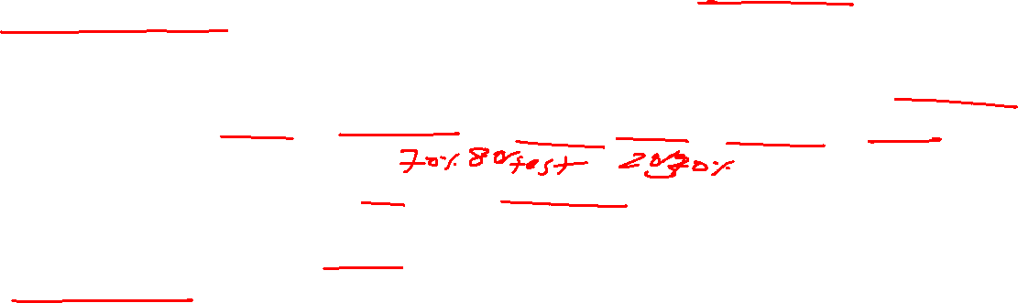
STEPS IN BUILDING A REGRESSION MODEL
STEP 1: Collect/Extract Data -- First collect or extract data on the dependent (outcome) variable and independent (feature) variables from different data sources.
STEP 2: Pre-Process the Data -- Before the model is built, it is essential to ensure the quality of the data for issues such as reliability, completeness, usefulness, accuracy, missing data, and outliers.
STEP 3: Divide the Data into Training and Validation Datasets -- The proportion of training dataset is usually 70%--80% of the data and the remaining data is treated as validation data. The subsets may be created using random/stratified sampling procedure. It is essential to check for any overfitting of the model.
STEP 4: Perform Descriptive Analytics/Data Exploration -- This step will help us understand the variability in the model and visualization of the data

Slide 4
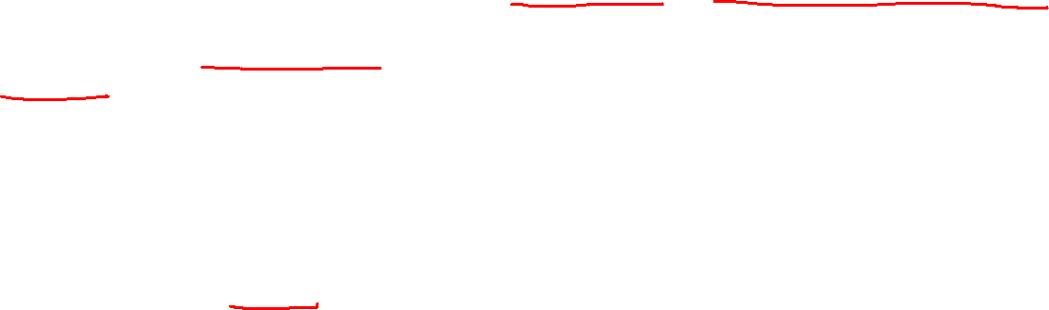
STEPS IN BUILDING A REGRESSION MODEL (contd…)
STEP 5: Build the Model – This is done using the training dataset to estimate the regression parameters.
STEP 6: Perform Model Diagnostics -- It is necessary that the model created is validated for all model assumptions including the definition of the function form. If the model assumptions are violated, then remedial measures must be used.
STEP 7: Validate the Model and Measure Model Accuracy – Due to overfitting, the model may perform very well on training dataset but it may perform badly in validation dataset. It is important to ensure that the model performance is consistent on both datasets.
STEP 8: Decide on Model Deployment -- Develop a deployment strategy in the form of actionable items and business rules.

Slide 5
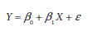
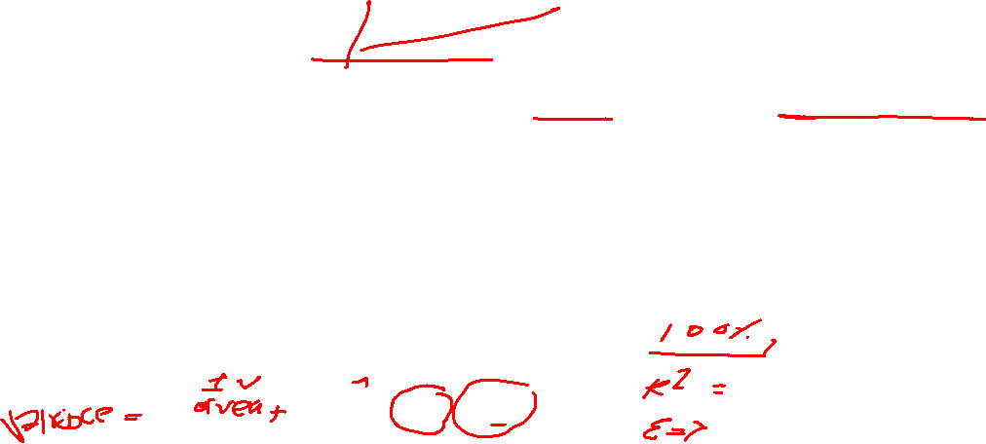
BUILDING SIMPLE LINEAR REGRESSION MODEL
In a simple linear regression model, there is only one independent variable (or feature).
The functional relationship between outcome variable and regression coefficient is linear.
Linear regression implies that the mathematical function is linear with respect to regression parameters.
One of the functional forms of SLR is as follows:

Slide 6
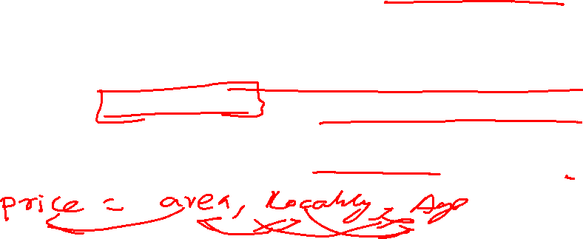
Assumptions of linear Regression Model
Errors or residuals ε_{i} are assumed to follow a normal distribution with expected value of error E(ε_{i}) = 0.
Variance of error, VAR(ε_{i}), is constant for various values of independent variable X. This is known as homoscedasticity (when the variance is not constant).
The error and independent variable are uncorrelated.
The functional relationship between the outcome variable and feature is correctly defined.

Slide 7
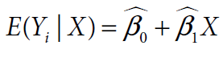
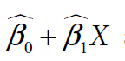
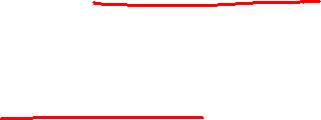
Properties of simple Linear Regression
1. The mean value of Y_{i} for given X_{i} is
2. Y_{i} follows a normal distribution with mean
and variance VAR(ε_{i}).

Slide 8
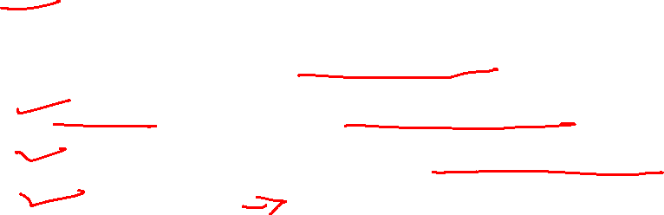
MODEL DIAGNOSTICS
It is important to validate the regression model to ensure its validity and goodness of fit before it can be used for practical applications.
The following measures are used to validate a simple linear regression model:
Co-efficient of determination (R-squared).
Hypothesis test for the regression coefficient.
Analysis of variance for overall model validity.
Residual analysis to validate the regression model assumptions.
Outlier analysis.

Slide 9
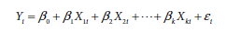
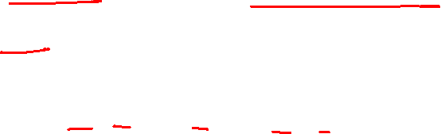
MULTIPLE LINEAR REGRESSION
It is a supervised learning algorithm for finding the existence of an association relationship between a dependent variable and several independent variables.
The functional form of MLR is given by
The regression coefficients β₁, β₂, … , β_{k} are called partial regression coefficients.
The relationship between an explanatory variable and the response variable is calculated after removing the effect all the other explanatory variables in the model.

Slide 10
Assumptions of MULTIPLE LINEAR REGRESSION
Regression model is linear in regression parameters (β-values).
Residuals follow a normal distribution.
Expected value (mean) of the residuals is zero.
In time series data, residuals are assumed to be uncorrelated.

Slide 11
Thank you

